Slide 1
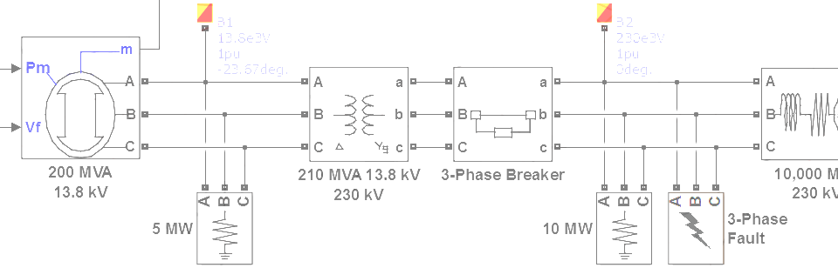

SimPowerSystems Hands-on Workshop: Modeling and Simulation of Electrical Power Systems with SimPowerSystemsTM
5. Control of Electrical Machines
Carlos Osorio
Principal Application Engineer
MathWorks – Natick, MA

Slide 2
Outline
Electrical disturbances
Emergency generator example
Control of synchronous generators
Generator droop control example
Load sharing example
Breaker synchronization example
Electric motor drives

Slide 3
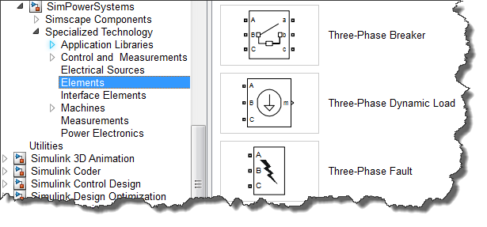
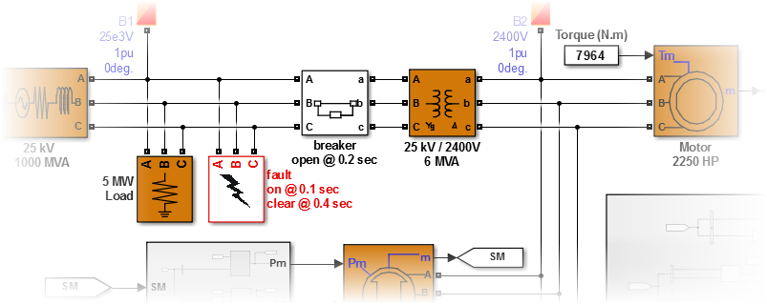
Electrical disturbances Emergency generator example
>> emergency_generator

Slide 4
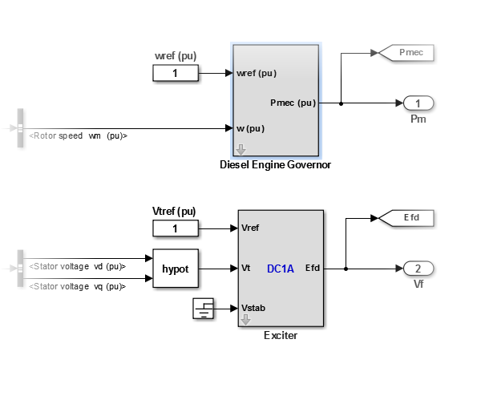
Electrical disturbances Emergency generator example
Examine the components in the generator control subsystem and identify the library that contains additional exciter models
Verify the performance of the generator after the fault occurs at 0.1 seconds and identify how long it takes for the motor to fully recover
1
3
Run a Load Flow initialization to start the simulation of the system from steady-state
Switch the simulation to phasor mode to speed up any additional testing of the system
2
4
>> emergency_generator

Slide 5
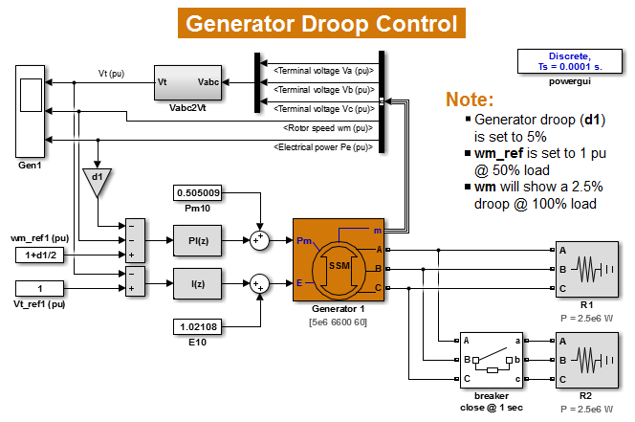
Synchronous generator control Generator droop control example
>> single_generator_droop

Slide 6
Synchronous generator control Generator droop control example
1
2.5% droop
@ 100% load
1
2
2
>> single_generator_droop

Slide 7
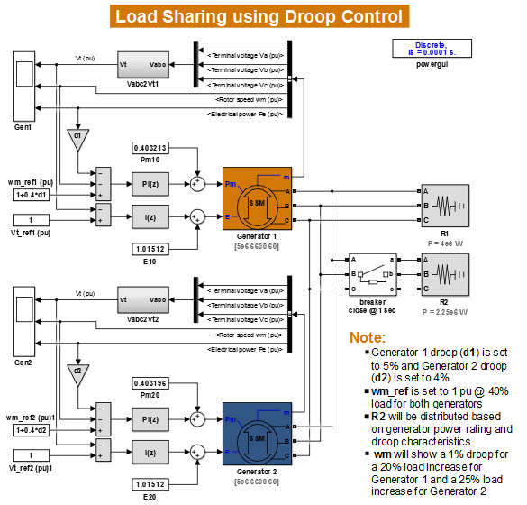
Synchronous generator control Load sharing example
The increase in load will be shared by the two generators based on their power ratings and their droop settings
>> two_generator_droop

Slide 8
Synchronous generator control Load sharing example
1
1
1% droop
2
20%
2
2
25%
>> two_generator_droop

Slide 9
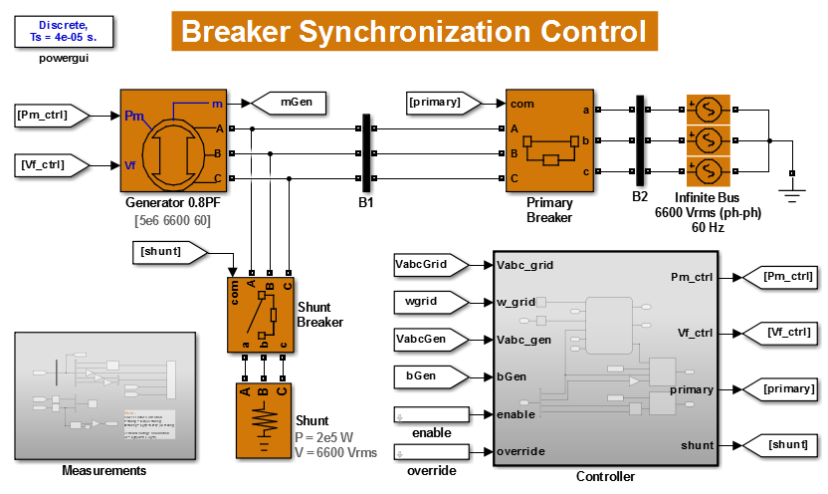
Synchronous generator control Breaker synchronization example
>> synchronizing_breaker

Slide 10
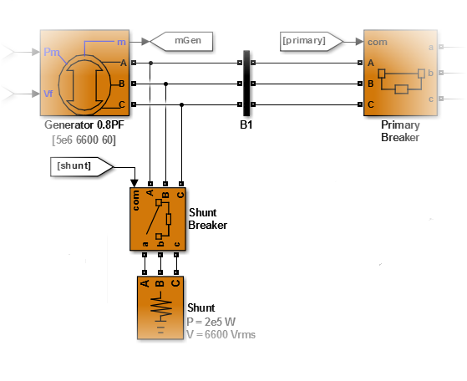
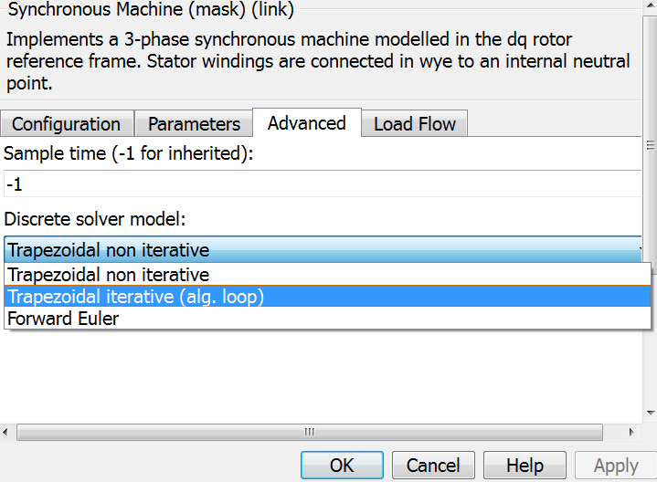
Synchronous generator control Breaker synchronization example
For numerical stability, always approximate a no-load condition by attaching a small shunt – between 1% and 5% of nominal –
at the output of the generator
When using Discrete simulation mode, you can choose the Trapezoidal Iterative algorithm to maintain solver stability with smaller shunts
>> synchronizing_breaker

Slide 11
Synchronous generator control Breaker synchronization example
There are two stages for synchronizing an incoming generator:
Establish the frequency of the incoming generator slightly above the bus frequency – within some tolerance
Connect when the voltage of the incoming generator is in-phase and equal in magnitude to the bus voltage – within some tolerance
1
2
1
2
generator
goes off-line
frequency
synch
phase
synch
synchronization
enabled
connection
made
>> synchronizing_breaker

Slide 12
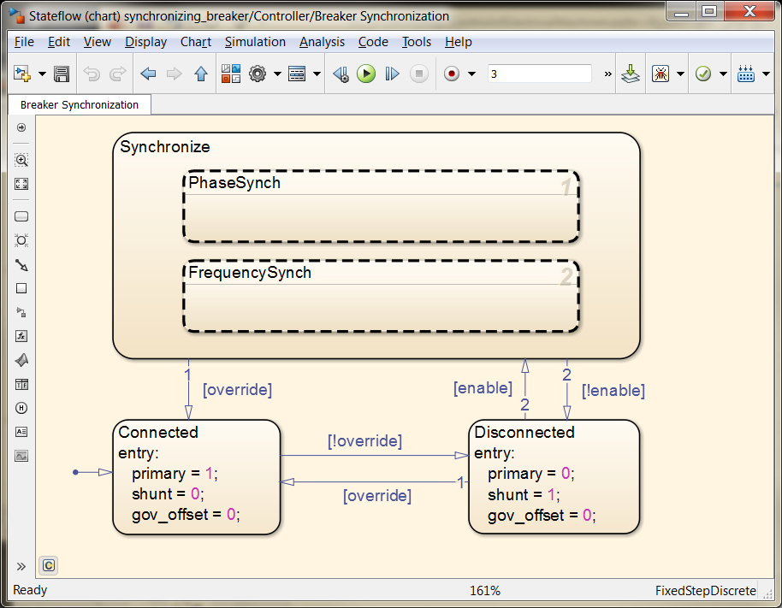
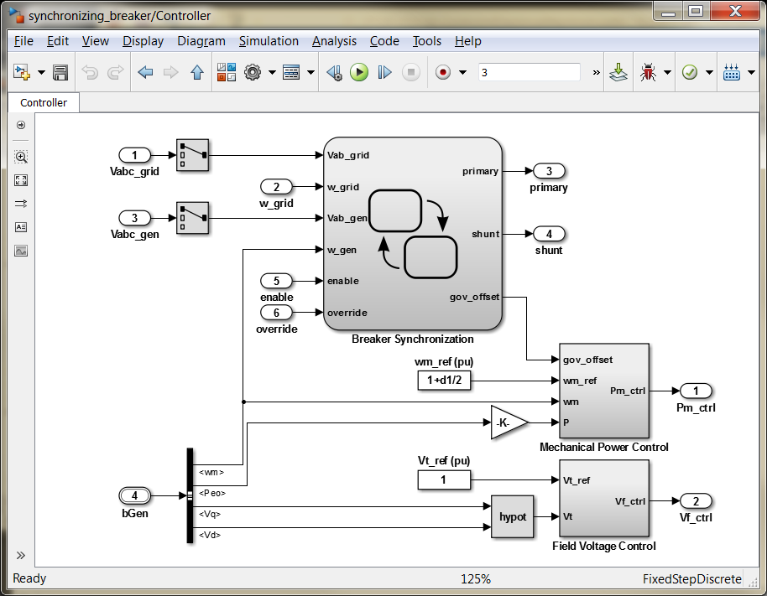
Synchronous generator control Breaker synchronization example
3
Examine the controller for an example of how management strategies for multiple circuit breakers can be easily implemented using state machine logic
>> synchronizing_breaker

Slide 13
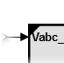
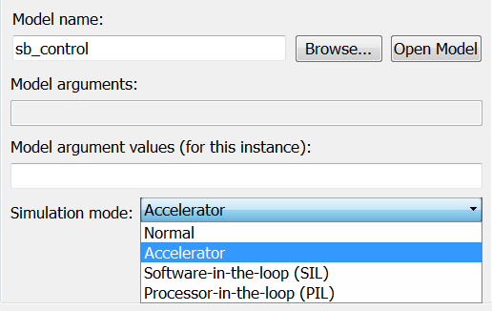
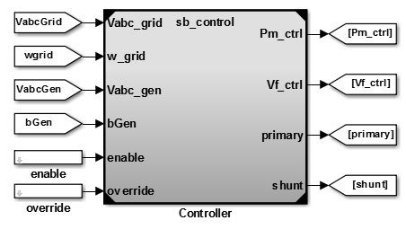
Synchronous generator control Breaker synchronization example
Place the controller in a separate model by converting the subsystem to a Model Reference
Subsystem & Model Reference → Convert Subsystem to → Referenced Model
4
5
Switch the simulation mode for the controller to Accelerator
Block Parameters (Model Reference) → Simulation mode
>> synchronizing_breaker_mref

Slide 14
Synchronous generator control Breaker synchronization example
6
Force an unsynchronized connection at 1.5 seconds by using the override signal
5
5
>> synchronizing_breaker_mref

Slide 15
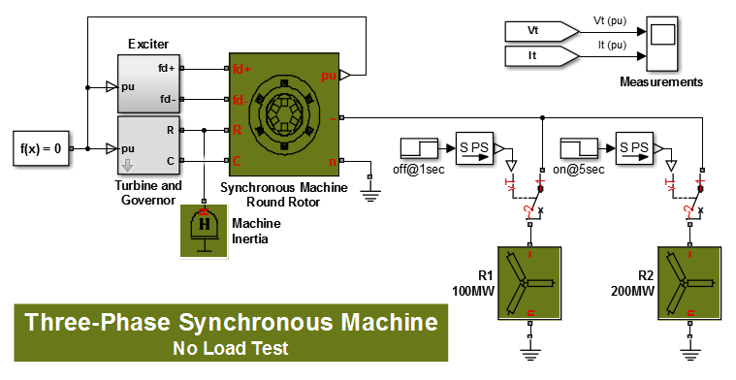
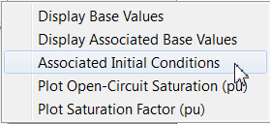
Synchronous generator control Generator no-load test – Simscape Components
The synchronous machine blocks in the Simscape Components library allow testing of no-load conditions without requiring a generator shunt
>> generator_noload_ssc

Slide 16
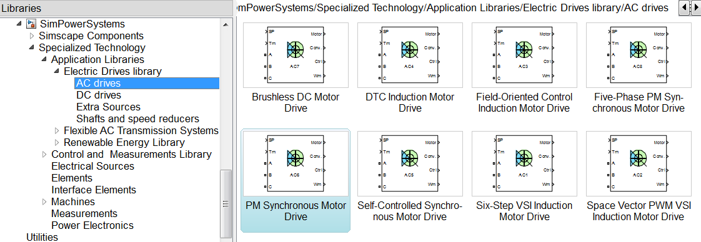
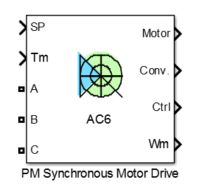
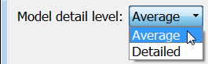
Electric motor drives Application libraries
Contain a variety of prebuilt AC and DC motor drive models that can be used directly or as starting templates

Slide 17
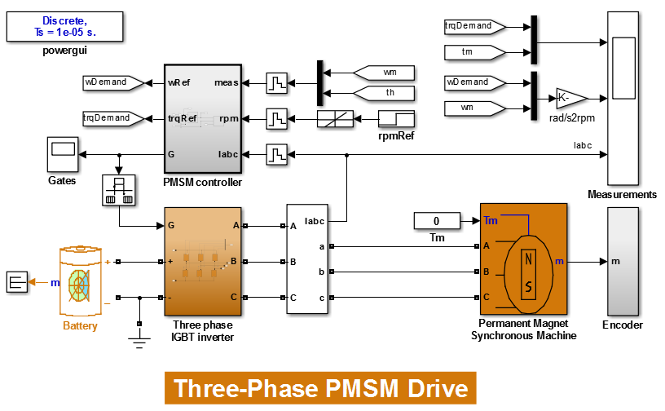
Electric motor drives Variable frequency drive
>> pmsm_drive_st

Slide 18
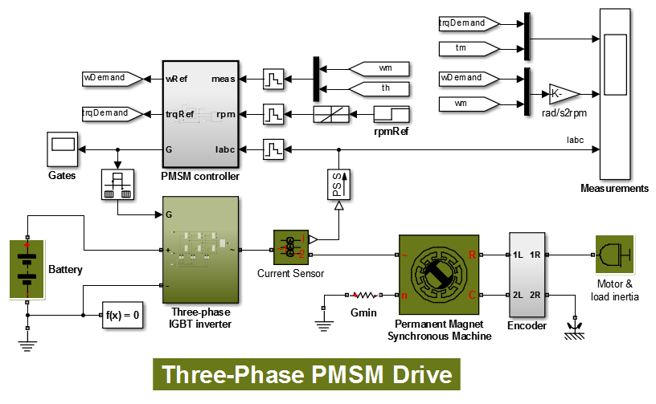
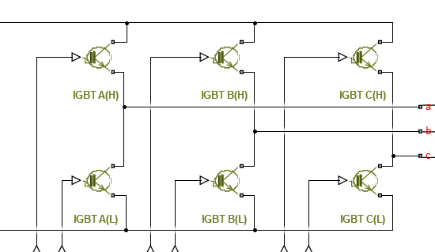
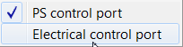
Electric motor drives Variable frequency drive – Simscape Components
Transistors can be quickly replaced with detailed nonlinear models from the SimElectronics library
>> pmsm_drive_ssc

